Slide 1


R Shiny Introduction
September 22, 2017

Slide 2
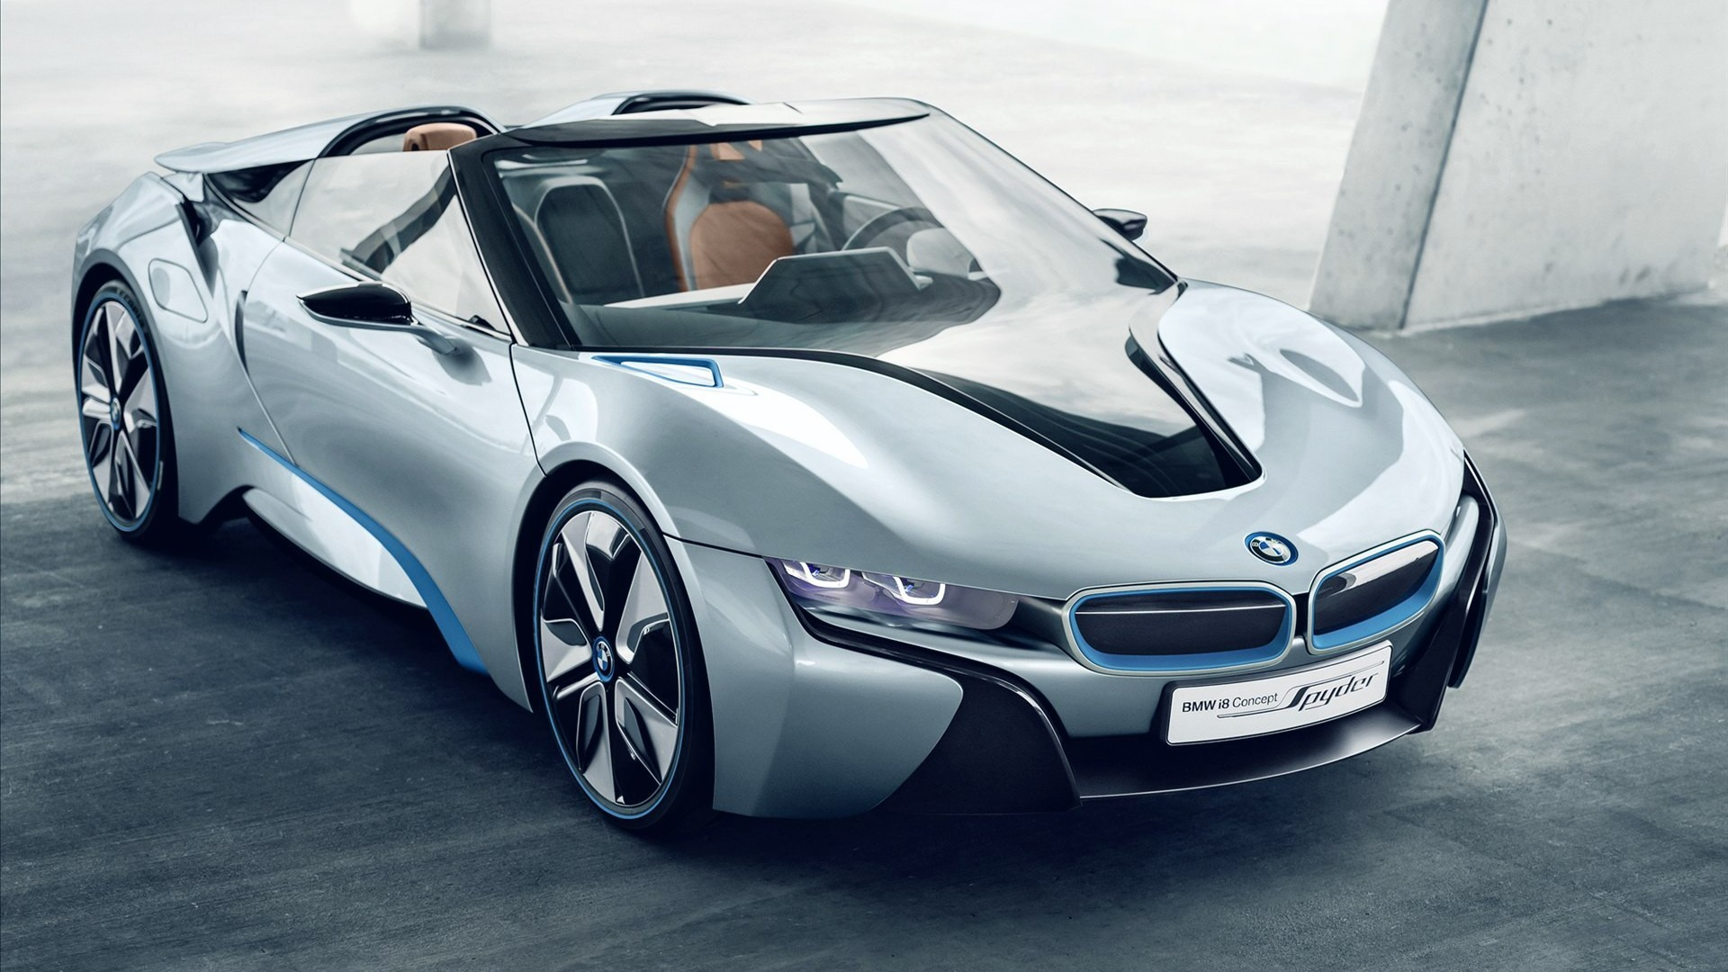
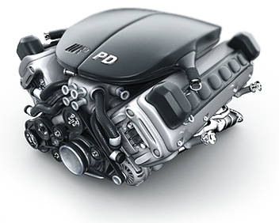

Shiny Basics
Communication
ui.R
server.R

Slide 3
ui.R
library(shiny)
shinyUI(fluidPage(
Make me pretty
))

Slide 4
server.R
library(shiny)
shinyServer(function(input, output) {
Make me smart
})

Slide 5
Communication
Data from user to server
input$var_name
Data from server to user
output$var_name

Slide 6



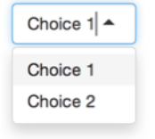
Types of Input
numericInput
sliderInput
fileInput
selectInput
etc

Slide 7
Sending information from server to ui
Object type | Server side (render*()) | ui side (*Output())
Data frame | renderDataTable | dataTableOutput
Image | renderImage | imageOutput
Plot | renderPlot | plotOutput
Print | renderPrint | verbatimTextOutput
Table | renderTable | tableOutput
Text | renderText | textOutput
output$x = renderText({
“I will print”
})
textOutput(“x”)

Slide 8
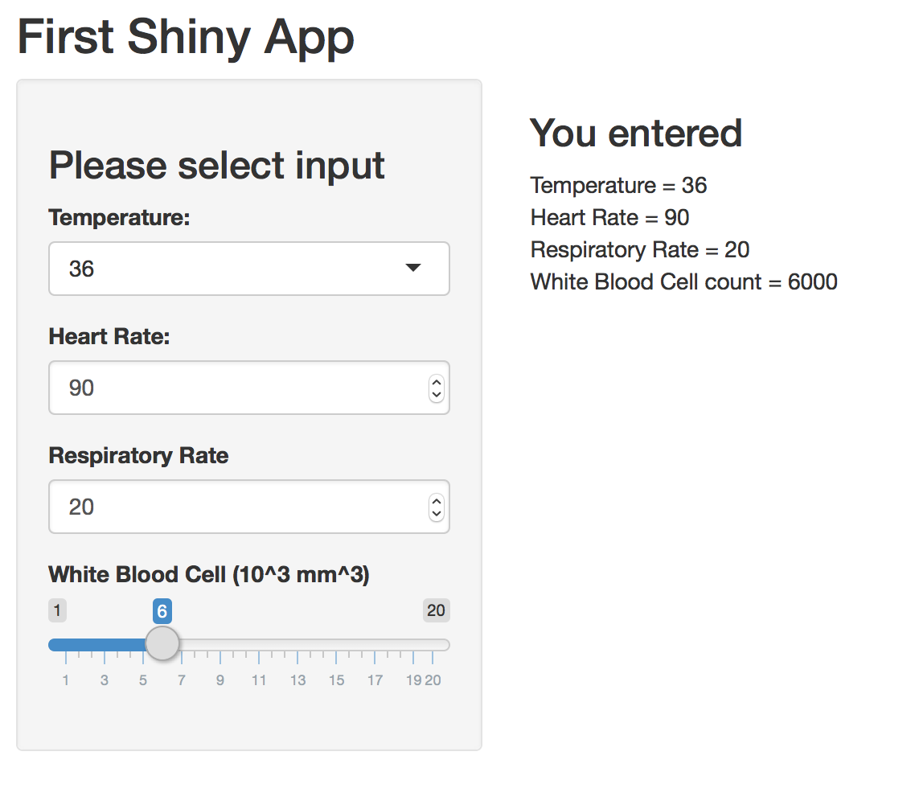
Today’s project

Slide 9
Let see things in action

